Slide 1
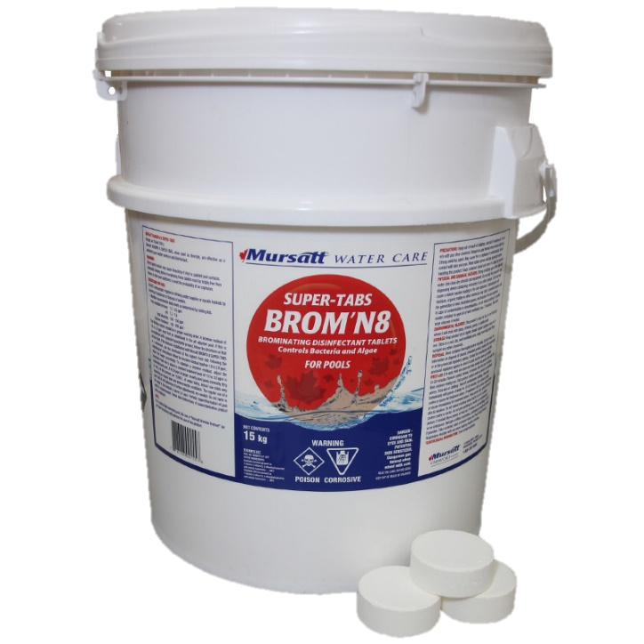
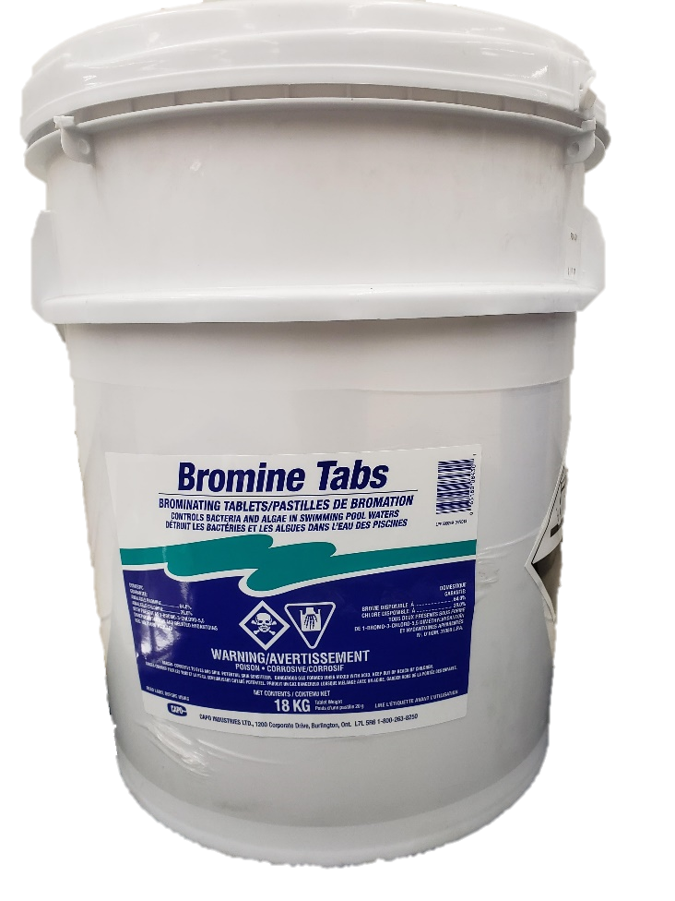
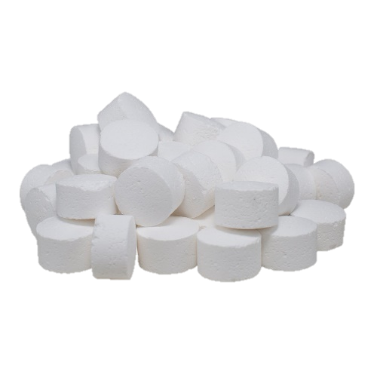
VS.
Bromine Super Tabs are larger, slow-release tablets that will keep a maintainable level of bromine in your pool for a longer period of time than our regular Bromine Tabs.

